Slide 1
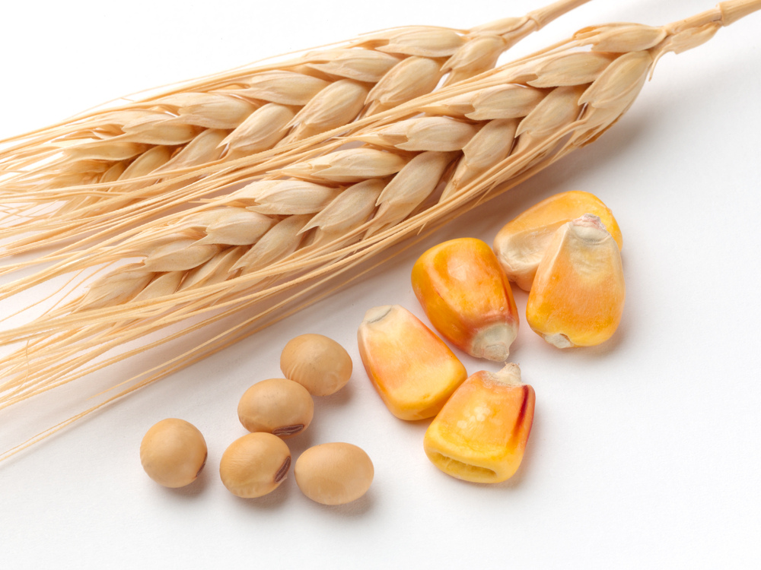
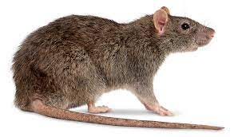
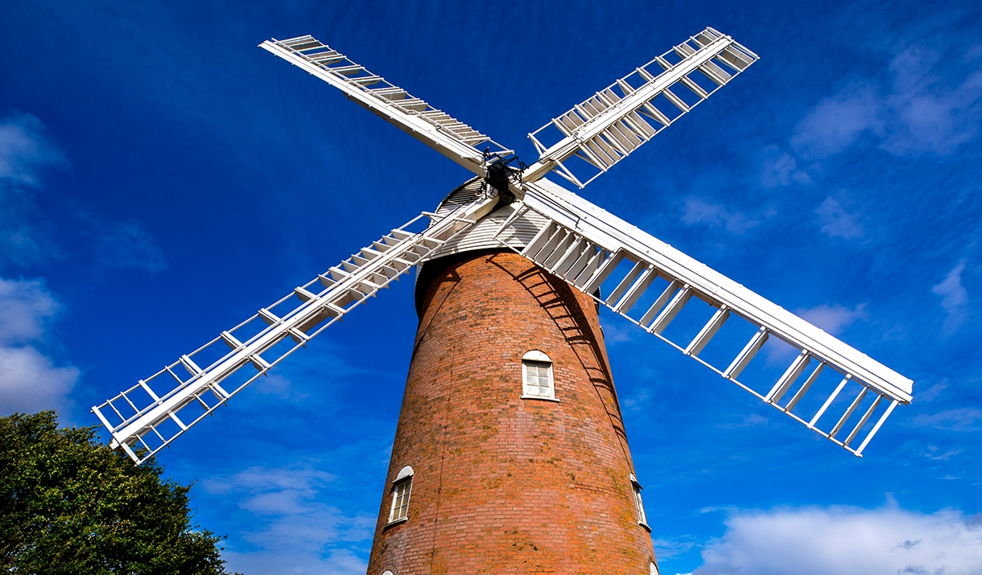
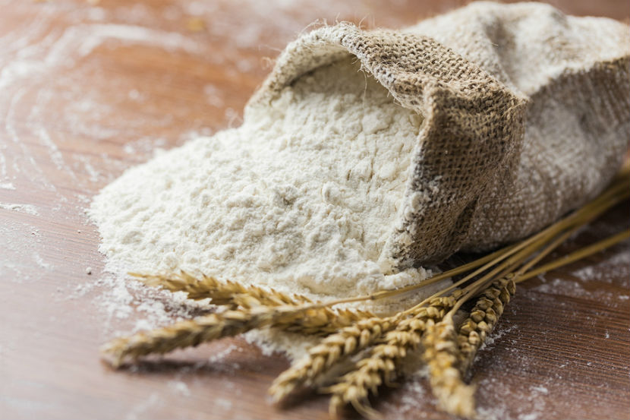
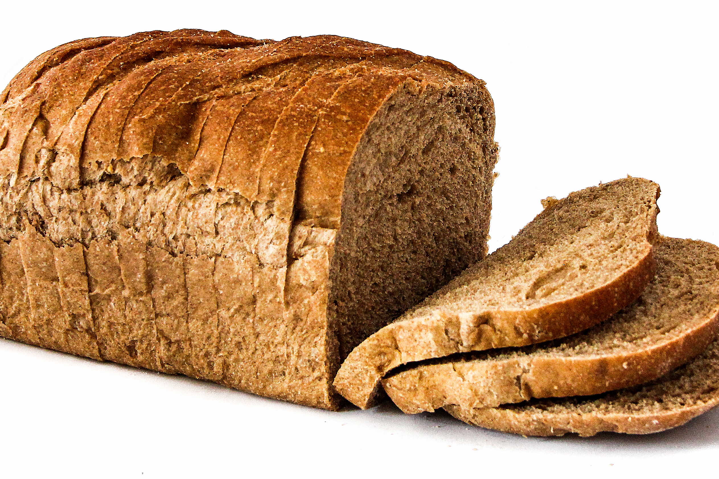
Story Vocabulary of the Week
Please see attached vocabulary that the children will be learning this week during our story time ‘The Little Red Hen’. Please spend some time with your child talking about these new words.
corn
rat
windmill
flour
bread

