Slide 1
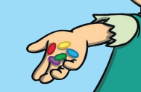
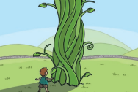
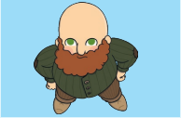
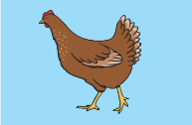
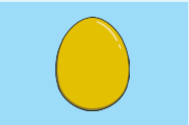
Story Vocabulary of the Week
Please see attached vocabulary that the children will be learning this week during our story time ‘Jack and the Beanstalk’. Please spend some time with your child talking about these new words.
magic beans
beanstalk
giant
hen
golden egg

