Slide 1
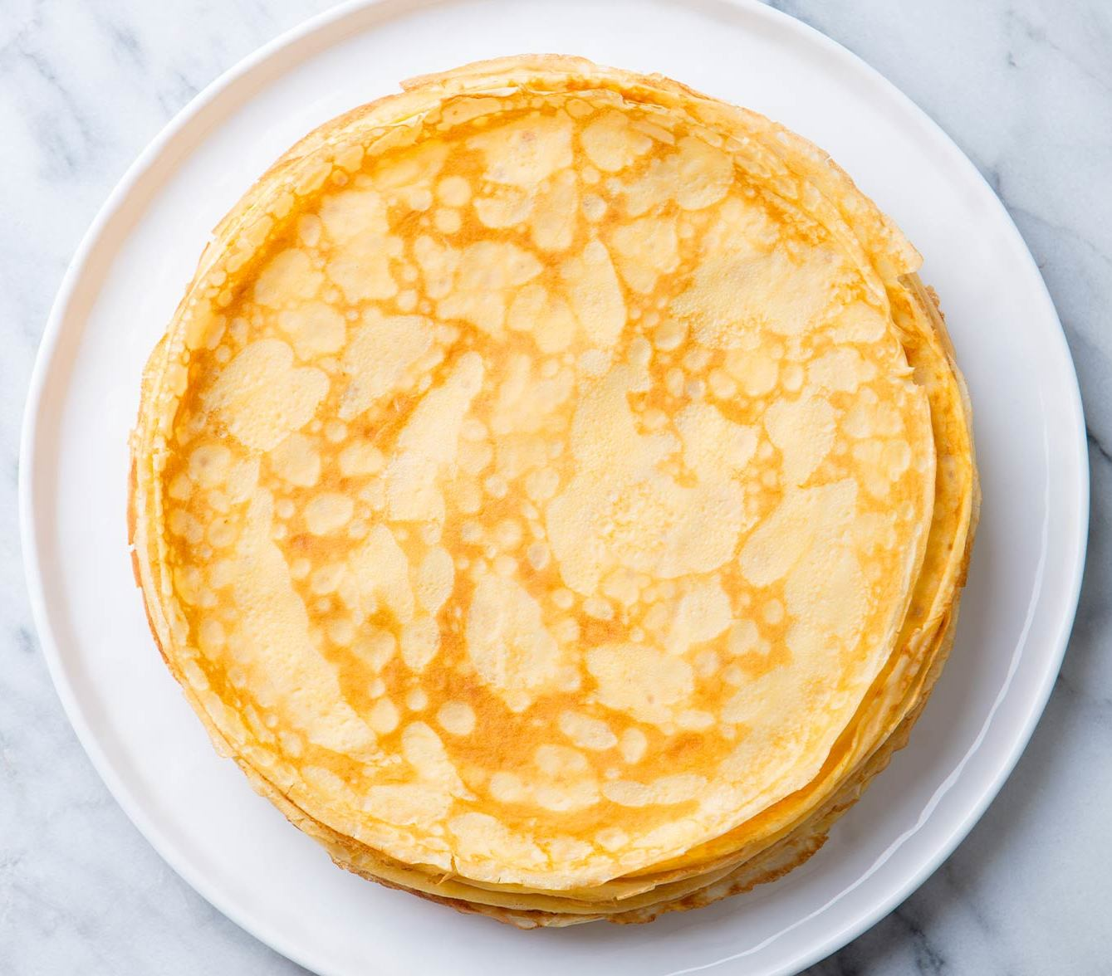
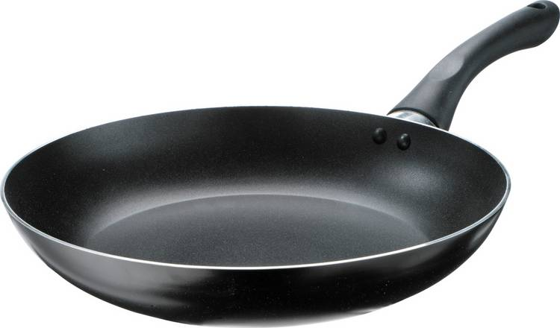
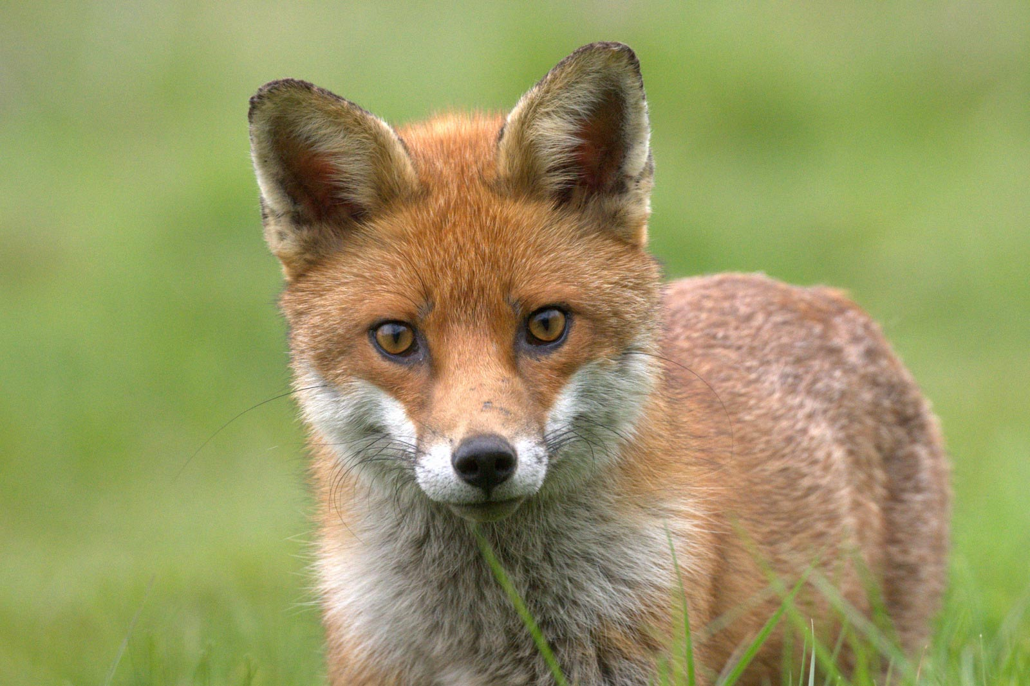
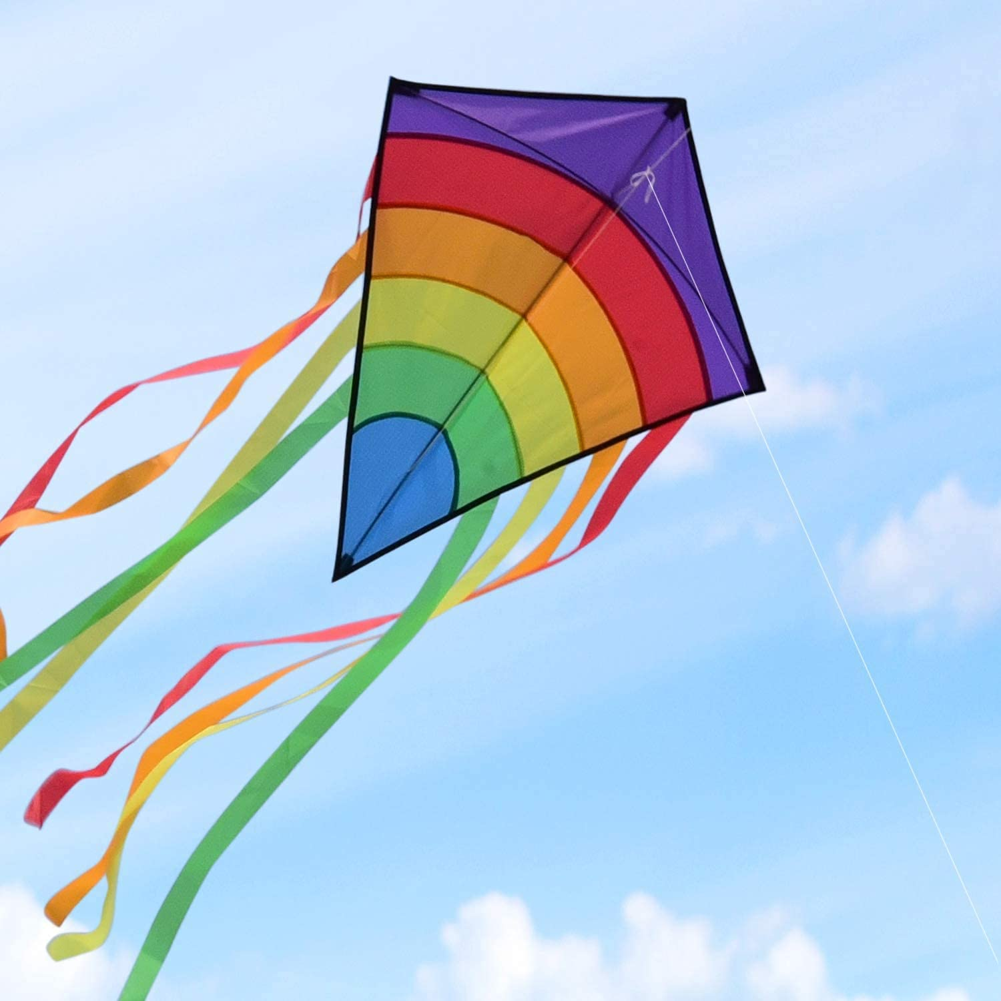
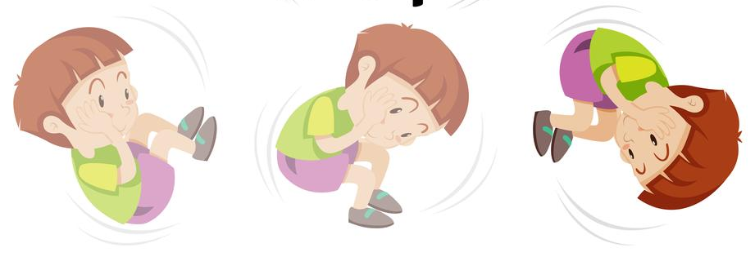
Story Vocabulary of the Week
Please see attached vocabulary that the children will be learning this week during our story time ‘The Runaway Pancake’. Please spend some time with your child talking about these new words.
pancake
frying pan
fox
kite
rolling

