Slide 1
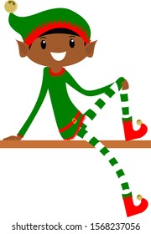
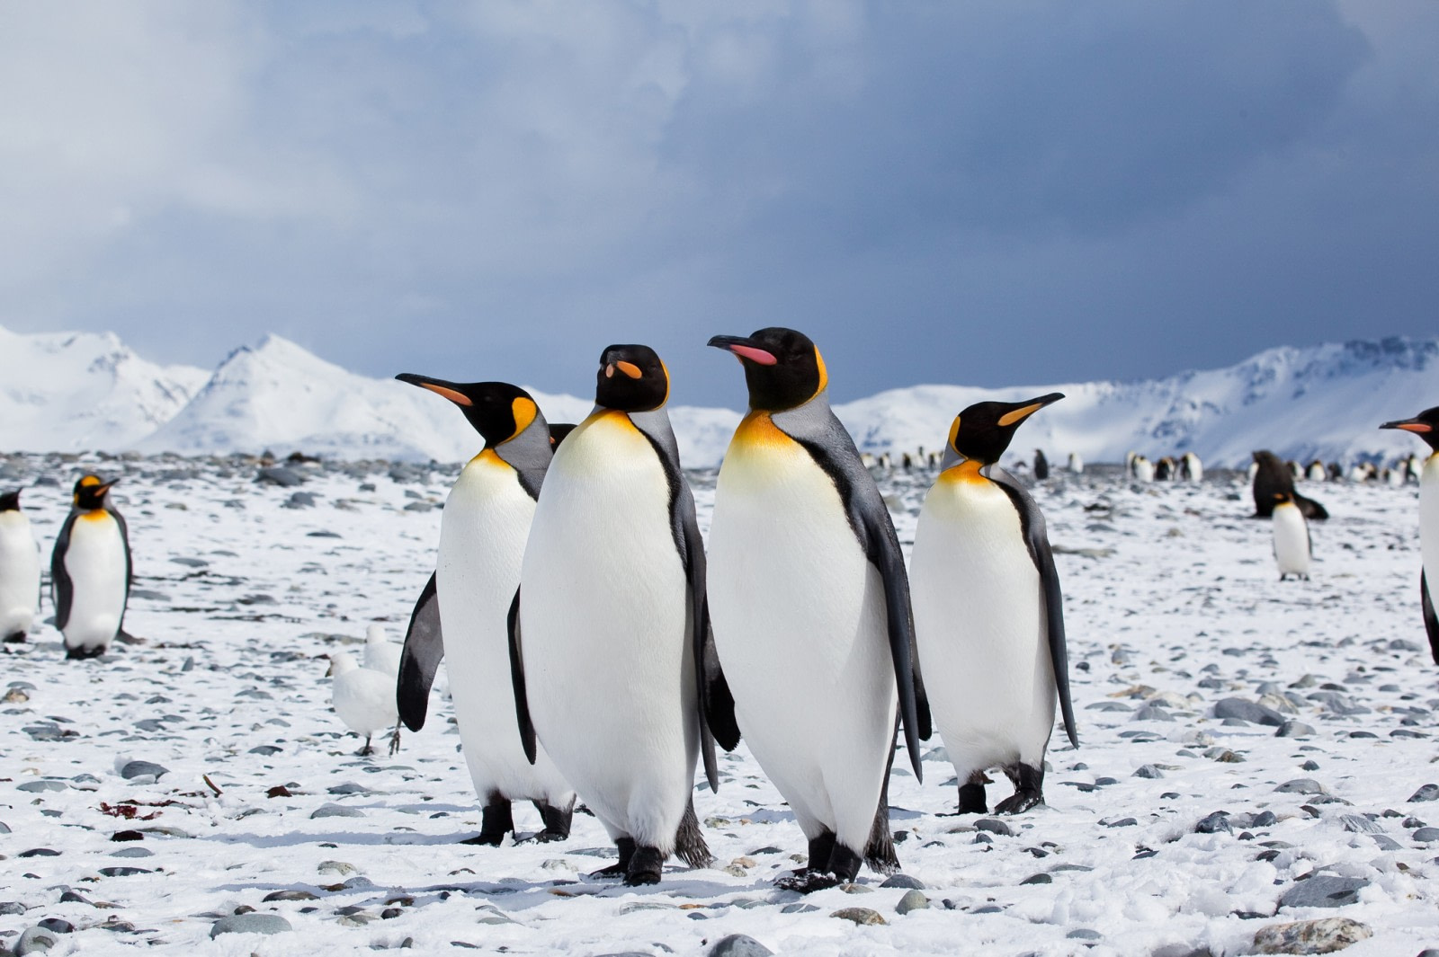
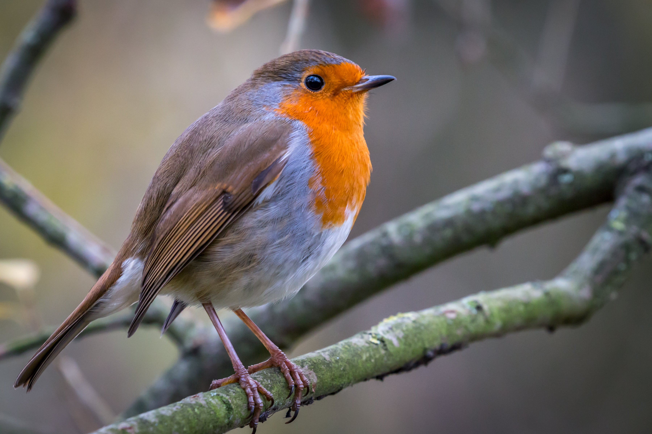
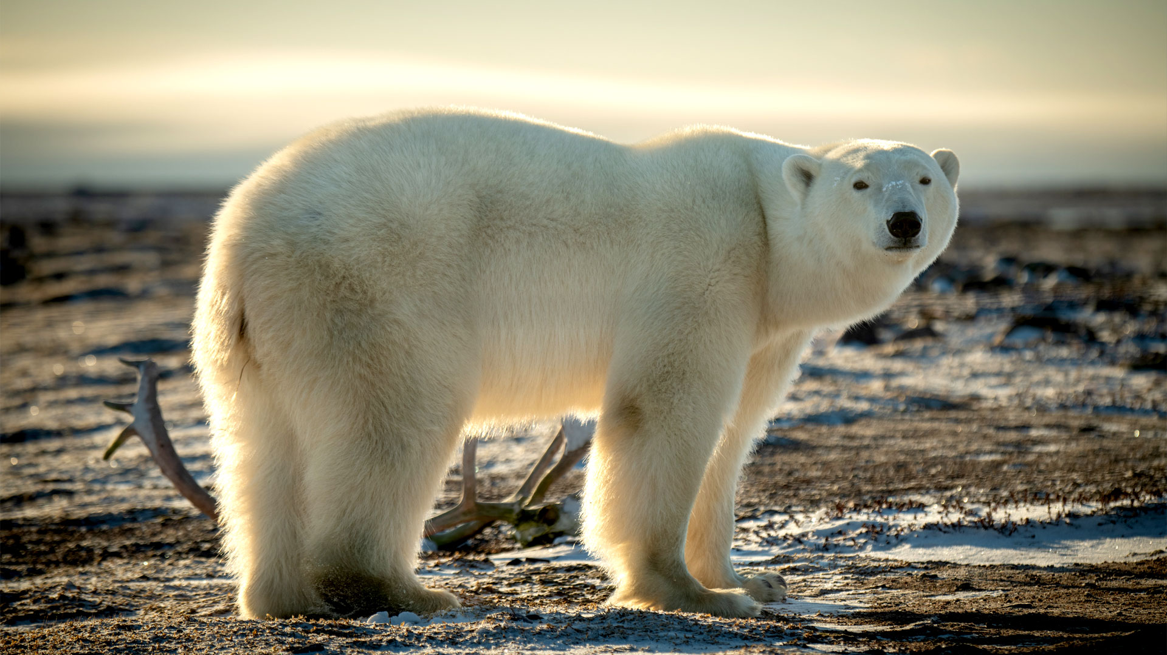
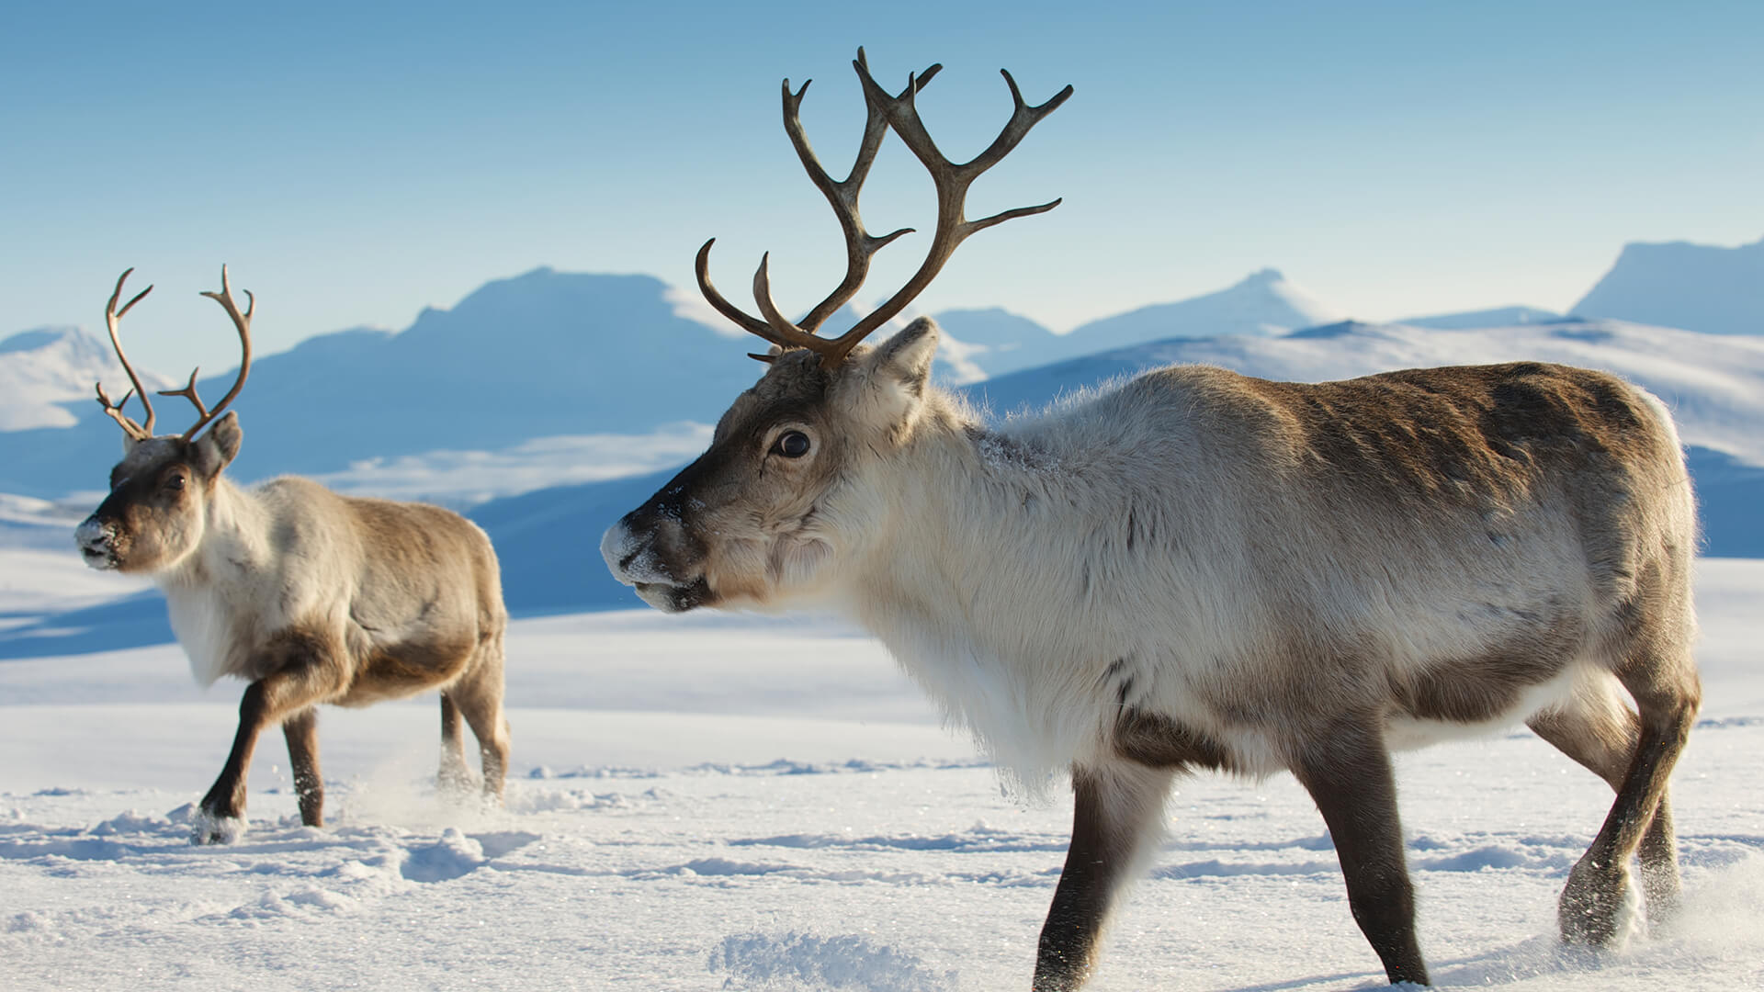
Story Vocabulary of the Week
Please see attached vocabulary that the children will be learning this week during our story time ‘We’re Going on an Elf Chase’. Please spend some time with your child talking about these new words.
elf
penguins
robin
polar bear
reindeer

