Slide 1
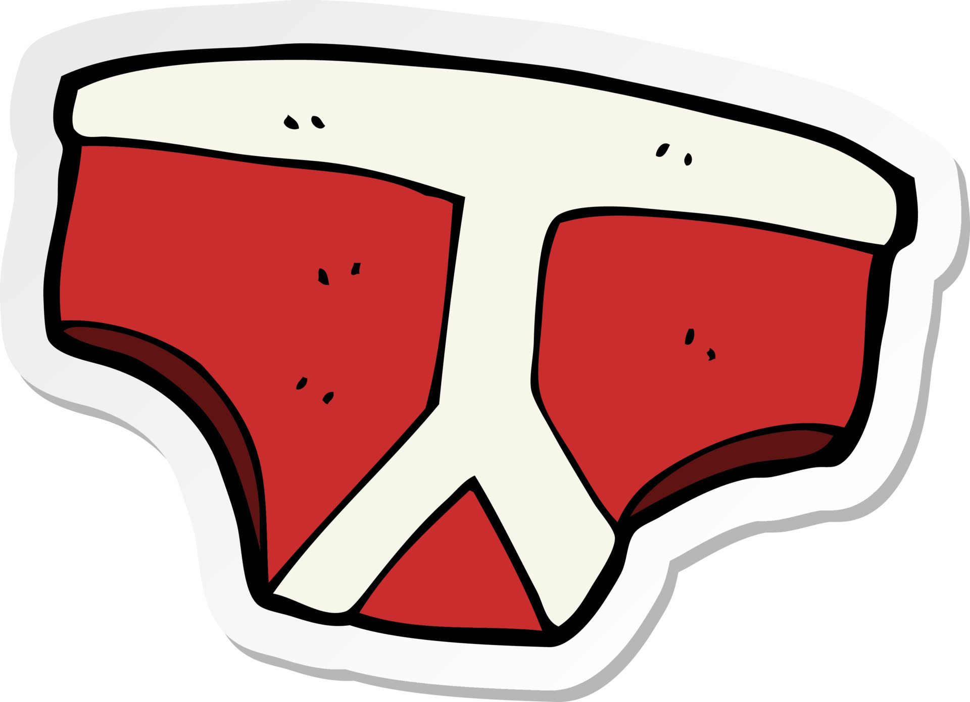
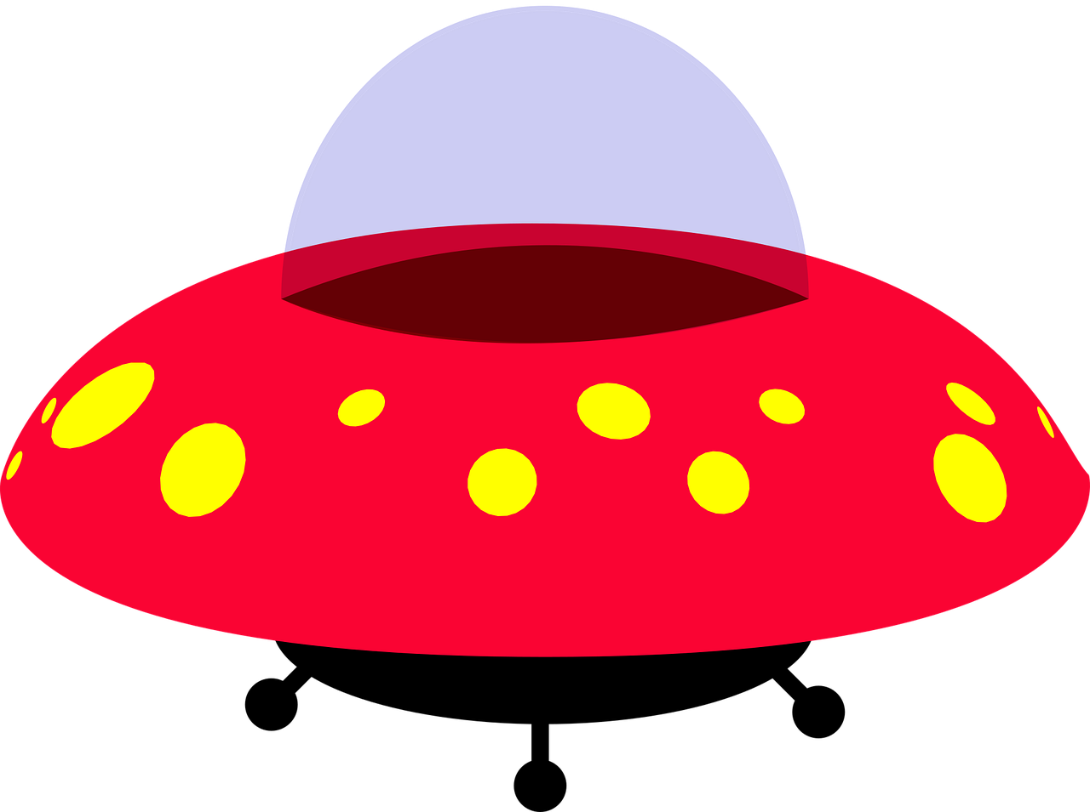
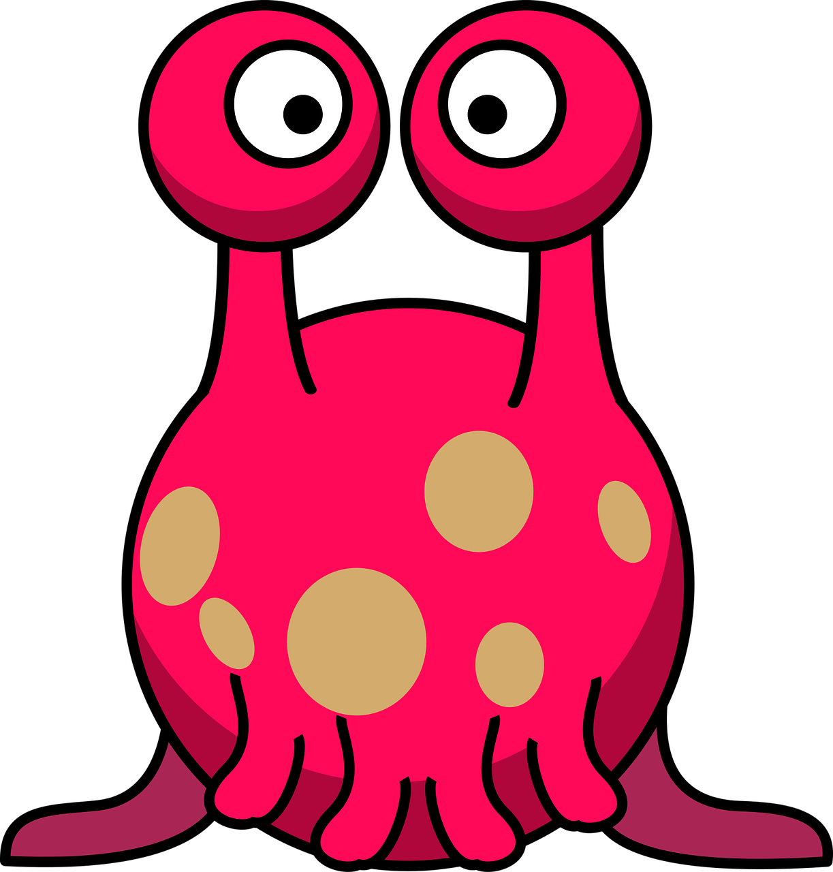
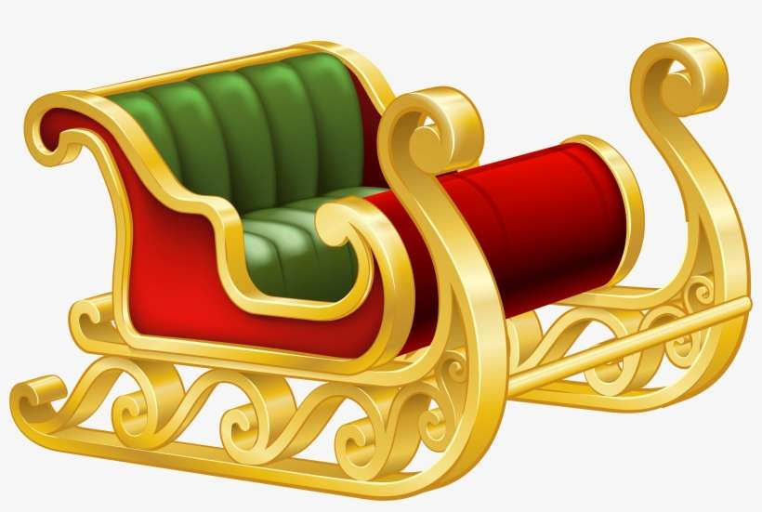
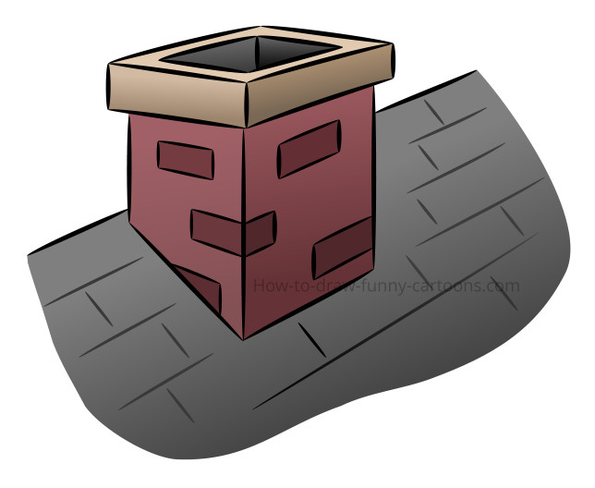
Story Vocabulary of the Week
Please see attached vocabulary that the children will be learning this week during our story time ‘Aliens Love Panta Claus’. Please spend some time with your child talking about these new words.
underpants
spaceship
alien
sleigh
chimney

